Slide 1
Digital Camera Technology

Slide 2
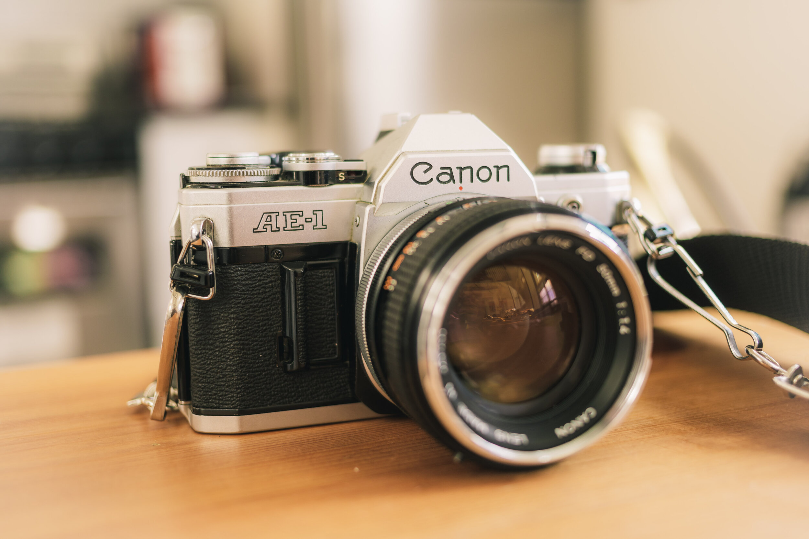
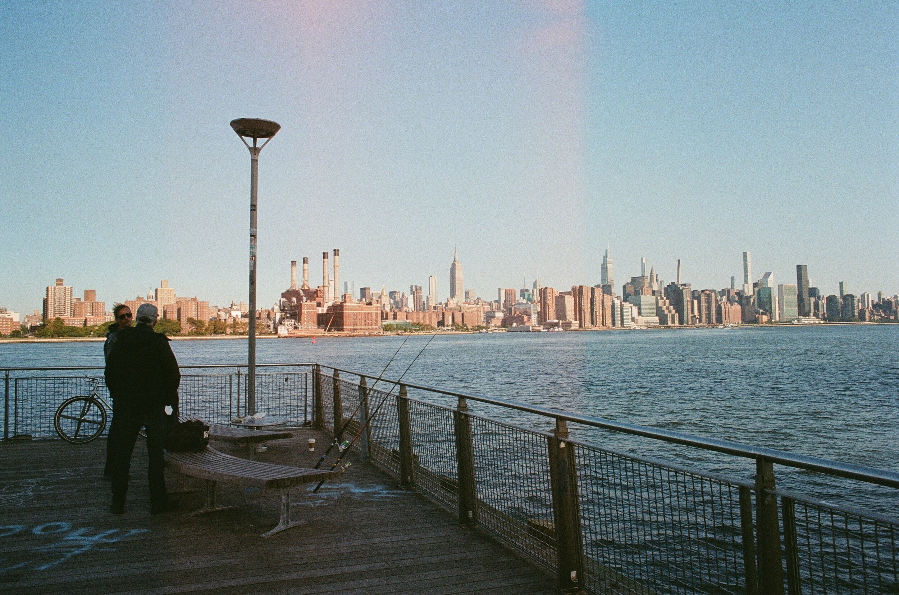
Before Digital Cameras
Film cameras use film that is covered in a light-sensitive chemical. When you press the button to take a photo, the aperture opens quickly to let a certain amount of light through the lens to the film, this causes a chemical reaction on the film therefore capturing the photo.
But to see the photos you have taken you would need to develop the film at a local pharmacy which could take up to a week. Then to even take it to the pharmacy, you would have to use up the entire film reel which can hold up to 35 photos.
Many people would just waste the film on random things just to see the four or five pictures they actually cared about.
With the growing inconvenience of simply taking photos, there came a solution: digital cameras.
Makalinao, Paulo. photo of a Canon film camera. 2020. Film Photography: What I Learned on.com/blog/fi My First Rolls of Film, Photo Paradox, https://www.photoparadoxlm-photography-what-i-learned-on-my-first-rolls-of-film. Accessed 2024.
Makalinao, Paulo. Photo of city skyline taken with film camera. 2020. Film Photography: What I Learned on.com/blog/fi My First Rolls of Film, Photo Paradox, https://www.photoparadoxlm-photography-what-i-learned-on-my-first-rolls-of-film. Accessed 2024.

Slide 3
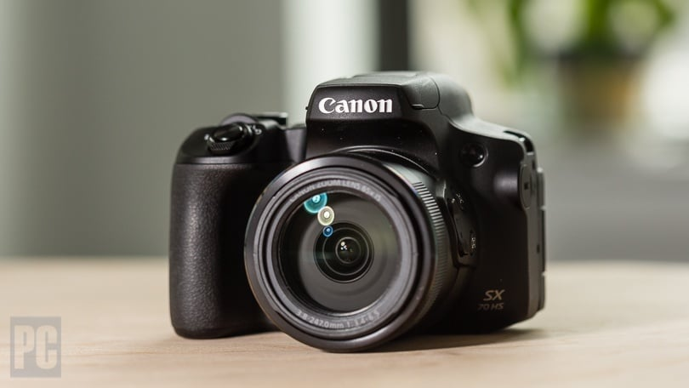
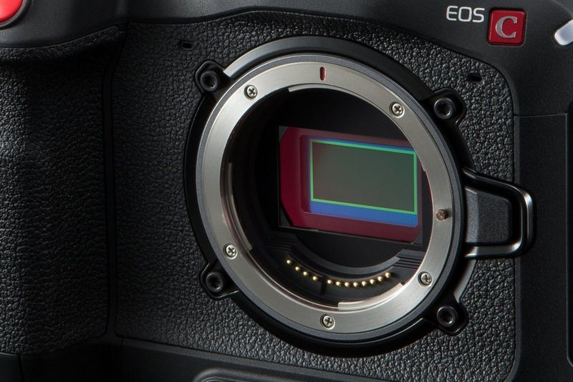
Digital Camera Technology
Digital cameras may look and feel like regular film cameras, but they work far differently from them.
Obviously, there is no film in a digital camera, there is a light detector that takes the incoming light rays and turns them into electrical signals. There are two types of light detectors, a charge-coupled device (CCD) or a CMOS image sensor.
So, when you press the photograph button, the aperture still opens to let light through the lens but the CCD or the CMOS image sensor takes the place of the film’s chemical reaction. When the picture reaches the sensor, it breaks it up into millions of pixels, measuring the color and brightness of every pixel and saving it as a numeric value.
Fisher, Jim. photo of Cannon digital camera. 2024. The Best Digital Cameras for 2024, https://www.pcmag.com/picks/the-best-digital-cameras. Accessed 2024.
Meyer , Jeff, and Alex Summersby. photo of CCD in a digital camera. 2024. Image Sensors Explained, https://www.canon-europe.com/pro/infobank/image-sensors-explained/. Accessed 2024.

Slide 4
CCD vs CMOS
Charged coupled devices (CCD) and complementary metal-oxide semiconductors (CMOS) are the main two types of image sensors. CCDs are commonly found in professional cameras (DSLR or mirrorless) and CMOSs are usually found in smartphone cameras.
CCD sensors can take high-quality photos, but they use a lot more power than CMOS sensors which have notably worse quality but can be placed inside more compact devices such as a smartphone camera.
Each have their respective pros and cons but clearly if you want a high-quality image for a special occasion, chances are, you’d want a camera with a CCD sensor and not your smartphone.

Slide 5
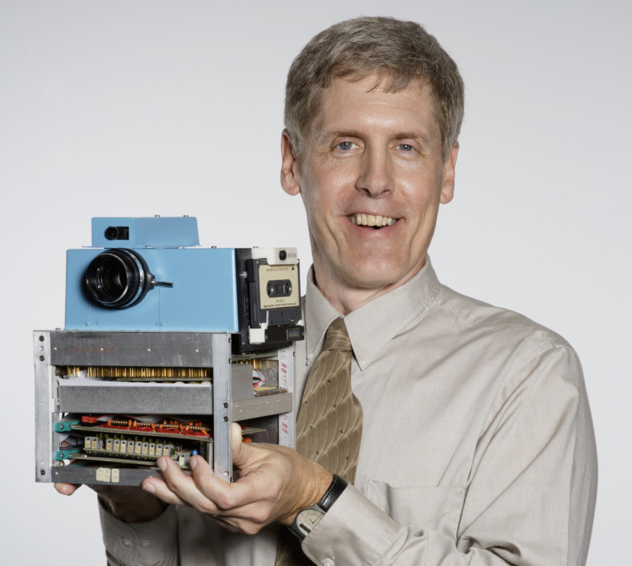
The First Digital Camera
The first-ever digital camera was invented in 1975, by Steven J. Sasson at Eastman Kodak, a photography company. At that time, CCDs had already been invented, it could capture images but it could not store it. To combat this problem, Sasson built a CCD into a camera with random-access memory (RAM) to store the image data to a cassette tape.
According to the article, “The First Digital Camera Was the Size of a Toaster” by Joanna Goodrich, “In a 2016 interview with DIY Photography, he [Sasson] said cassettes were the only permanent form of ‘digital storage’ available to him at the time. He designed it so each tape would store 30 images” (Goodrich 2022).
Mistry, Phil. Sasson with Camera, Photo courtesy Eastman Kodak Company. 2022. How Steve Sasson Invented the Digital Camera, https://petapixel.com/how-steve-sasson-invented-the-digital-camera/. Accessed 2024.

Slide 6
The First Digital Camera (cont.)
To build the camera, Sasson also took many different parts from old Kodak movie cameras. It weighed about 7 pounds and was around the size of a toaster and took 16 AA batteries. The first photo was taken in December of 1975, it was of one of the lab technicians. To store it on the computer and then view the photo, it took around a minute to process which is definitely unlike cameras and even computers today.
This camera was able to display the photos on any monitor such as a computer or a television. When they displayed the photo on the computer, they saw a black-and-white photo, but the face of the technician was static. Sasson went on to fix the problems in 1978, but his prototype never made it past development.
Later on in 1994, Sasson developed one of the first commercially available digital cameras for Nikkon, the AP NC2000.

Slide 7
How are Digital Images Stored?
The one setback to digital photos is the amount of storage that they can quickly take up on your computer. Due to the camera storing millions of numbers for just one picture, the file size can get up to four megabytes when it should be around 200 to 500 kilobytes. The solution that they came up with is called “compression”.
Compression is a technique that crushes digital photos so they can have fewer numbers, which shrinks the size. A well-known form of compression is called “JPG”, it is “lossy” meaning that the shrink in size causes some information to be lost forever.
All digital cameras have settings where you can choose either a high-resolution or a low-resolution which determines the size and clarity of the photo.

Slide 8
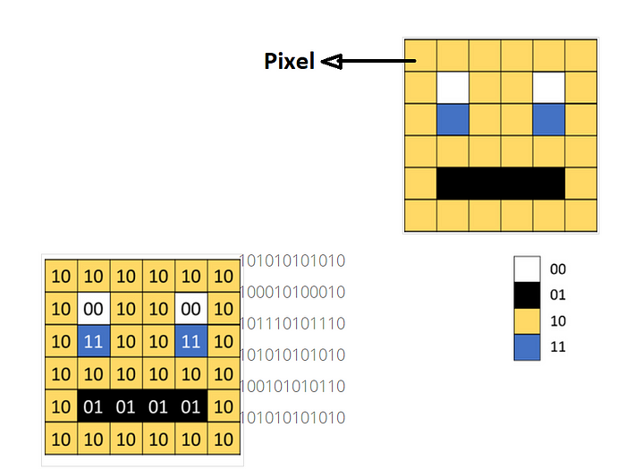
How are Digital Images Stored? (cont.)
As mentioned before images are broken down into thousands and thousands of pixels. Every single pixel in an image has a numeric value assigned to it. It’s assigned as a binary value. Each color has its own binary value. So, when every pixel comes together it looks like the image in full color and quality.
Ragipally, Alekya. Example of Binary value for a colored image. 2020. How Images Are Stored on a Computer?, https://alekya3.medium.com/how-images-are-stored-in-a-computer-f364d11b4e93. Accessed 2024.

Slide 9
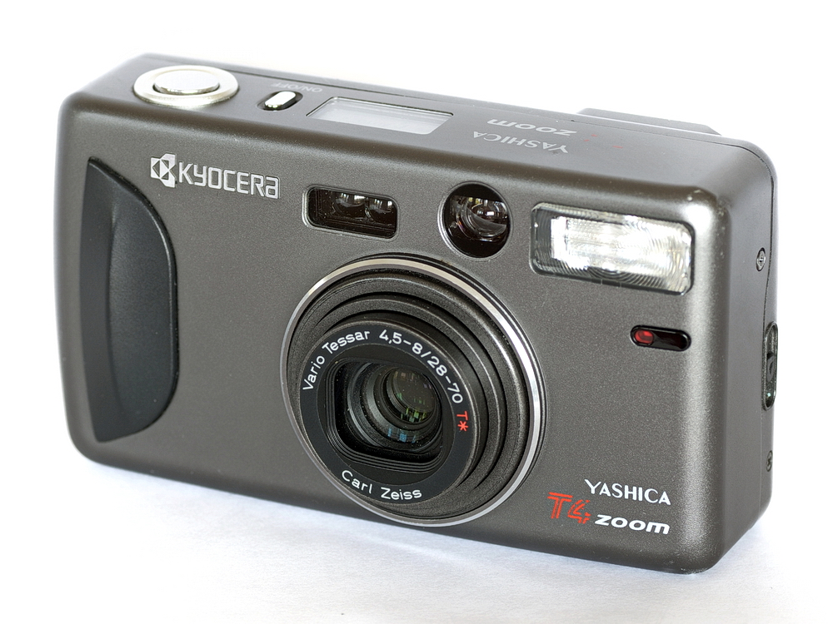
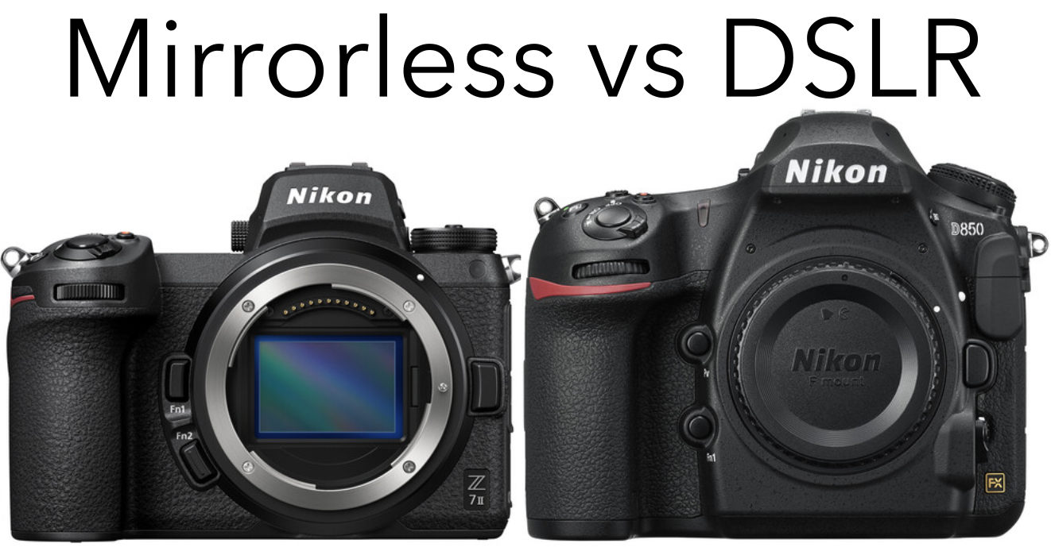
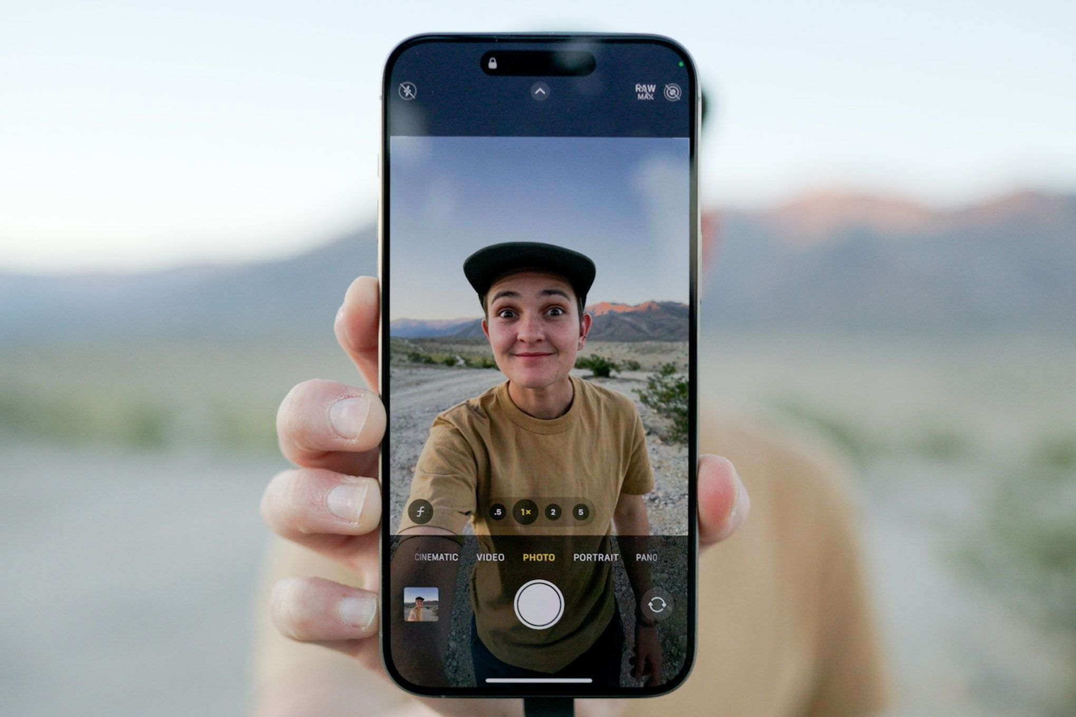
Different Types of Digital Cameras
Gary. YASHICA T4 ZOOM. 2020. Wide-Angle Point-and-Shoot Showdown, https://filmadvance.com/2020/05/wide-angle-point-and-shoot-showdown/.
There are a few different types of digital cameras, old “point and shoot” cameras that just have the bare necessities of a digital camera, a lens, and an image sensor. There is usually a very low-quality screen to show you the image that you are about to take.
Then there’s the Digital Single Lens Reflex (DSLR) which has a hinged mirror inside that reflects light up to the viewfinder to show you what the lens sees and what the photo you are going to take will look like. Many professional photographers use the DSLR because the viewfinder is very accurate to real life since the image is coming straight from the lens.
Within the last 12 years, mirrorless digital cameras have grown in popularity. They get rid of the mirror function of the DSLR and instead have an LCD viewfinder that shows exactly what the image sensor sees, giving you a very accurate depiction of the photo.
Most notably, the final digital camera is the smartphone.
Mansurov, Nasim. Mirrorless vs. DSLR. 2024. DSLR vs Mirrorless Cameras, https://photographylife.com/mirrorless-vs-dslr. Accessed 2024.
Farsace, Becca. photo of Becca Farsace taking a photo on their iPhone 15. 2023. 1,000 Photos Later, and the iPhone 15 Pro Max Is Still Missing Something, The Verge, https://www.theverge.com/23899983/iphone-15-pro-max-camera-apple-full-frame. Accessed 2024.

Slide 10
Smartphone Cameras
Everyone has one and everyone takes photos with them but are they better than a mirrorless camera or a DSLR? No, although smartphones like Apple or Samsung have been getting better over the years, they can never replace mirrorless or DSLRs. This is simply because smartphone cameras have smaller image sensors than mirrorless or DSLRs
The size of the sensor is important because larger sensors tend to have better image quality, and they also do better in low-light situations. Smartphones can take good photos during the day but just go out at night and take a photo. There will be a massive amount of grain (visual distortion) due to light not reaching the small sensor. Mirrorless and DSLRs do not have this problem because they can adapt to any lighting.
A major setback to smartphones is the lack of “optical zoom”. Optical zoom refers to when you can zoom in on the “subject”, (the main focus of a photo), and the picture enlarges due to the lens magnifying the image. Smartphones have “digital zoom”, that’s when you zoom in on the subject but instead the pixels are being enlarged which reduces the quality significantly. That’s why on smartphones the image gets very “fuzzy” when you zoom in all the way.

Slide 11
Smartphone Cameras (cont.)
Another interesting quality of mirrorless/DSLR cameras is the ability to change the lenses. Interchangeable lenses allow the camera to have different “focal lengths” which is the distance from the point where light meets the image sensor.
So, while you can zoom in, it does not change the actual focal distance. It is almost like a magnifying glass, so the higher the focal length, the longer the distance and the higher the magnification. Different types of lenses allow you to have larger or shorter focal lengths.
It is an important part of photography that gives the user creative freedom when taking photos, that are lost when transitioning to phone cameras, and losing creativity is not something a photographer would want.
The only way smartphones would replace mirrorless/DSLRs would be overall convenience to not buy an expensive phone as well as an expensive camera. Other than that, smartphone images will never beat the quality of a mirrorless/DSLR image.

Slide 12
How Have Cameras Shaped Society?
The photography industry and overall hobby have boomed in only the last 20 years, or so, thanks to the simplicity and convenience that digital cameras have brought to the market. So, while cameras used to be just taking images of certain memories/occasions, they have evolved to be much more.
Each and every person with a smartphone can now relive every moment in their lives through photos. They can save hundreds of thousands of photos and can look back on each one with the ease of a search bar instead of having to find and look through a scrapbook.
Being able to store and share photos so quickly and effortlessly has changed society for the better and maybe the worse, but mainly for the better.

Slide 13
Camera Technology Recap
There are a variety of different types of digital cameras for almost every type of occasion/person. They are all massively different, but they all have the same inner core and workings. That would be a light detector (either a CCD or a CMOS) that takes the incoming light rays and turns them into electrical signals to capture images.
The biggest difference being the size of these sensors, which drastically changes the quality of the image and the overall usefulness of the camera in certain settings. Camera technology has come a long way from being the size of a toaster all the way to being able to fit in our pockets. But due to the light sensor technology, we are still a long way away from our smartphone cameras being as sophisticated as professional photography cameras (i.e. mirrorless or DSLR cameras).

Slide 14
References
Goodrich, Joanna. “The First Digital Camera Was the Size of a Toaster.” IEEE Spectrum, IEEE Spectrum, 29 Mar. 2023, spectrum.ieee.org/first-digital-camera-history.
Chris Woodford. “How Do Digital Cameras Work?” Explain That Stuff, 6 Mar. 2022, www.explainthatstuff.com/digitalcameras.html.
Australia, Reckoner. “10 Reasons Why Mirrorless Cameras Beat Smartphones Every Time.” Reckoner, 10 May 2019 reckoner.com.au/features/10-reasons-why-mirrorless-cameras-beat-smartphones-every-time/.

